Slide 1
Lect# 3, More types, Methods, Conditionals

Slide 2
Variables
Named location that stores a value
Example:
String a = “a”;
String b = “letter b”;
a = “letter a”;
String c = a + “ and “ + b;
Operators
Symbols that perform simple computations
Assignment: =
Addition: +
Subtraction:
Multiplication: *
Division: /

Slide 3
Q. GravityCalculator :
Compute the position of a falling object:
x(t) = 0.5 × at² + v^{i}t + x^{i}
import javax.swing.*;
public class GravityCalculator2{
public static void main(String[ ] args) {
double gravity = -9.81;
double initialVelocity = 0.0;
double fallingTime= 10.0;
double initialPosition = 0.0;
double finalPosition = 0.5 * gravity * fallingTime * fallingTime;
finalPosition = finalPosition + initialVelocity * fallingTime;
finalPosition = finalPosition + initialPosition;
JOptionPane.showMessageDialog(null, "An object's position after " + fallingTime + "seconds is " + finalPosition + "m.", "Results", JOptionPane.PLAIN_MESSAGE);
}
}

Slide 4
Division
Division (“/”) operates differently on
integers and on doubles!
Example:
double a = 5.0/2.0; // a = 2.5
int b = 4/2; // b = 2
int c = 5/2; // c = 2
double d = 5/2; // d = 2.0

Slide 5
Order of Operations
Precedence like math, left to right
Right hand side of = evaluated first
Parenthesis increase precedence
double x = 3 / 2 + 1; // x = 2.0
double y = 3 / (2 + 1); // y = 1.0
Mismatched Types
Java verifies that types always match:
String five = 5; // ERROR!
test.java.2: incompatible types found: int required: java.lang.String
String five = 5;

Slide 6
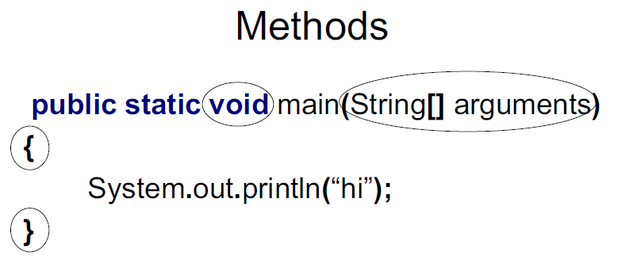
Conversion by casting
int a = 2; // a = 2
double a = 2; // a = 2.0 (Implicit)
int a = 18.7; // ERROR
int a = (int)18.7; // a = 18
double a = 2/3; // a = 0.0
double a = (double)2/3; // a = 0.6666…

Slide 7
Adding Methods
public static void NAME () {
STATEMENTS
}
To call the above method from main(….) :
NAME();

Slide 8
public class NewLine {
public static void newLine() {
System.out.println("");}
public static void threeLines() {newLine(); newLine(); newLine();}
public static void main(String[] arguments){ System.out.println("Line 1");
threeLines();
System.out.println("Line 2");
} }

Slide 9
Parameters
public static void NAME(TYPE NAME) { STATEMENTS
}
To call from main(….) :
NAME(EXPRESSION);
Example : Method
public class Square {
public static void printSquare(int x){JOptionPane.showMessageDialog(null, “ “ + x * x, "Results", JOptionPane.PLAIN_MESSAGE); }
public static void main(String[] arguments){
int value = 2; printSquare(value); printSquare(3); printSquare(value*2); } }

Slide 10
public class Square2 {
public static void printSquare(int x){ System.out.println(x*x); }
public static void main(String[] arguments){ printSquare("hello");
printSquare(5.5);
} }
What’s wrong here?

Slide 11
public class Square2 {
public static void printSquare(int x){ System.out.println(x*x); }
public static void main(String[] arguments){ printSquare("hello");
printSquare(5.5);
} }
What’s wrong here?

Slide 12
Multiple Parameters
void NAME(int NAME, String NAME) { STATEMENTS
}
To call the above non-static method in main
using constant values, we would write ???????
public class Multiply { public static void times (double a, double b){
JOptionPane.showMessageDialog(????(a * b)); }
public static void main(String[] arguments){ times (2, 2); times (3, 4);
} }

Slide 13
Return Values
public static TYPE NAME() { STATEMENTS
return EXPRESSION;
}
void means “no type” i.e method returns no value
public class Square4 { public static double square(double x){ return x*x; }
public static void main(String[] arguments){JOptionPane.showMessageDialog(????(square(5))); JOptionPane.showMessageDialog(???? square(2)); } }

Slide 14
Variable Scope
Variables live in the block ({ }) where they are defined (scope)
Method parameters are like defining a new variable in the method

Slide 15
public class SquareChange {
public static void printSquare(int x){ System.out.println("printSquare x = " + x);
x = x * x;
JOptionPane.showMessageDialog(???? “printSquare x =“ +x ); }
public static void main(String[] arguments){ int x = 5;
JOptionPane.showMessageDialog(????“main x =“ +x );
printSquare(x);
JOptionPane.showMessageDialog(????“main x =“ +x );
} }
OUTPUT?

Slide 16
public class Scope {
public static void main(String[] arguments){ int x = 5;
if (x == 5){
int x = 6;
int y = 72;
System.out.println("x = " + x + " y = " + y);
}
System.out.println("x = " + x + " y = " + y);
} }
OUTPUT?

Slide 17
Methods: Building Blocks
Big programs are built out of small methods Methods can be individually developed, tested and reused
User of method does not need to know how it works
In Computer Science, this is called “abstraction”
Mathematical Functions
Math.sin(x)
Math.cos(Math.PI / 2)
Math.pow(2, 3)
Math.log(Math.log(x + y))

Slide 18
Conditional Statements
if statement
if (CONDITION) {
STATEMENTS
}
public static void test(int x){
if (x > 5)
{ JOptionPane.showMessageDialog (???? x + " is > 5"); }
}
public static void main(String[] arguments){ test(6); test(5); test(4);
}

Slide 19
Relational (Comparison) operators
x > y: x is greater than y
x < y: x is less than y
x >= y: x is greater than or equal to y
x <= y: x is less than or equal to y
x == y: x equals y
( equality: ==, assignment: = )
Array Declaration in Java:
Initialized Array:
int[ ] array= {10, 5, 9, 40, 33, 15, 22, 4, 7, 12};
Uninitialized Array:
int[ ] array2 = new int[10];

Slide 20
Boolean operators
Boolean Logical Operator (&, |, ^:XOR, ||, &&,
!, &=, !=, ^=, ==, !=, ?:
boolean a = true;
boolean b = false;
boolean c = a | b;
boolean d = a & b;
boolean e = a ^ b;
boolean f = (!a & b) | ( & !b) ;
boolean g = !a;
Short Circuit Logical Operators
if (denom !=0 && num /denom > 10) // No run-time
//Exception when denom == 0
if (denom !=0 & num /denom > 10) // Run-time
//Exception when denom == 0

Slide 21
Bitwise Operators
~ = Bitwise unary NOT
& = Bitwise AND
| = Bitwise OR
^ = Bitwise XOR
>> = shift right
>>> = shift right zero fill
<< = shift left
&= Bitwise AND assignment
|= Bitwise OR assignment
^= Bitwise Exclusive OR Assignment
>>= Shift Right assignment
>>>= Shift Right Zero fill Assignment
<<= Shift left Assignment
boolean k = 7 & 8;//error
int L = 7 & 8;
int L = 7 && 8;//error

Slide 22
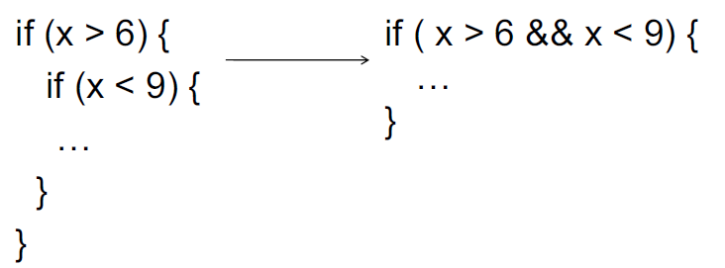

Slide 23
else
if (CONDITION) { STATEMENTS
} else {
STATEMENTS
}
public static void test(int x){
if (x > 5){
JOptionPane.showMessageDialog(????x + " is > 5"); }
else {
JOptionPane.showMessageDialog(????x + " is not > 5"); } }
public static void main(String[] arguments){ test(6); test(5); test(4); }

Slide 24
else if
if (CONDITION) {
STATEMENTS
} else if (CONDITION) {
STATEMENTS
}
else if (CONDITION) {
STATEMENTS
}
else {
STATEMENTS
}

Slide 25
public class Testing{
public static void test(int x){
if (x > 5){
JOptionPane.showMessageDialog(???x + " is > 5"); }
else if (x == 5){
JOptionPane.showMessageDialog(???x + " equals 5");
}
else {
JOptionPane.showMessageDialog(???x + " is < 5"); } }
public static void main(String[] arguments){ test(6); test(5); test(4);
}

Slide 26
Assignment: FooCorporation
Method to print pay based on base pay and hours worked
Overtime: More than 40 hours, paid 1.5 times base pay
Minimum Wage: $8.00/hour
Maximum Work: 60 hours a week
Solution: Next Lecture

Slide 27
Conversion by method
int to String:
String five = 5; // ERROR!
String five = Integer.toString (5);
String five = “” + 5; // five = “5”
String to int:
int foo = “18”; // ERROR!
int foo = Integer.parseInt (“18”);

Slide 28
Comparison operators
• We can call == on doubles
double a = Math.cos (Math.PI / 2);
double b = 7.5; double c =7.5
boolean a = c == b
will return TRUE!

Slide 29
Ternary Operator
The ternary operator, also known as the conditional operator, can be used as an alternative to the Java if/then/else syntax
minVal = (a < b) ? a : b;
int absValue = (a < 0) ? -a : a;
result = testCondition ? value1 : value2;
String result = false ? "Dude, that was true" : "Sorry Dude, it's false";

Slide 30
Random Generator
import java.util.Random;
Random rand = new Random();
for(int i=0; i<100; ++i)
requirementArr[i] = rand.nextInt(100);
Q. How to generate unique random numbers using Random
Generator at each iteration?
Q. How to find if the array is sorted or not? Returns a boolean
value
Example Programs
Find Larger of Two inputted Numbers (use JOptionPane.inputMessageDialog)
Find Larger of Three Numbers inputted Numbers
Find Grade of inputted marks.
Find whether the inputted Number is +ve, -ve or zero
Find whether the inputted Number is Even/Odd

